Slide 1
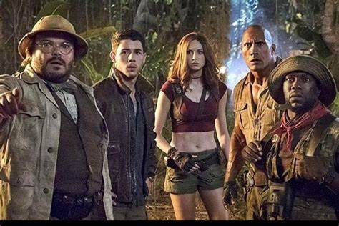
Welcome to our prototype
Game Name=JUMANJI(the land of Adventure)
Team Name=Legend Warriors
Round=3(final round)
Organized by=P.M.I(Project Management Institute)

Slide 2
Description about game
In Our Game Here Is a Land Called Jumanji With full of Adventures. the eneIn Our Game Here Is a Land Called Jumanji With full of Adventures. the enemies have evil cast eye to capture this land of paradise for their own purpose.
Players in a team have to save Jumanji from these enemies to reach the enemies we solve clues,disalarming bombs and capturing outposts.
The team consist of Jumanji Characters-
1.Dr. Xander "Smolder" Brave stone
2.Professor Sheldon "Shelly" Oberon
3.Franklin "Mouse" Finbarr
4.Jefferson "Seaplane" McDonough
5.Ruby Roundhouse

Slide 3
Commands of prototype
Shift +w(start walking)
Reload-R
Grenade-G
Fire- left mouse button
Sprint - shift
Crouch-C
Primary weapon-1
Secondary weapon-2
Aim down sighting- Right mouse button
Turn -mouseX
Lookup-Y

Slide 4
RULES
Do not leave
Do not leave a mission until it was finished.
Fire
Friendly fire is not tolerated.
Do not kill
Do not kill any civilian or any animal in the forest.

Slide 5
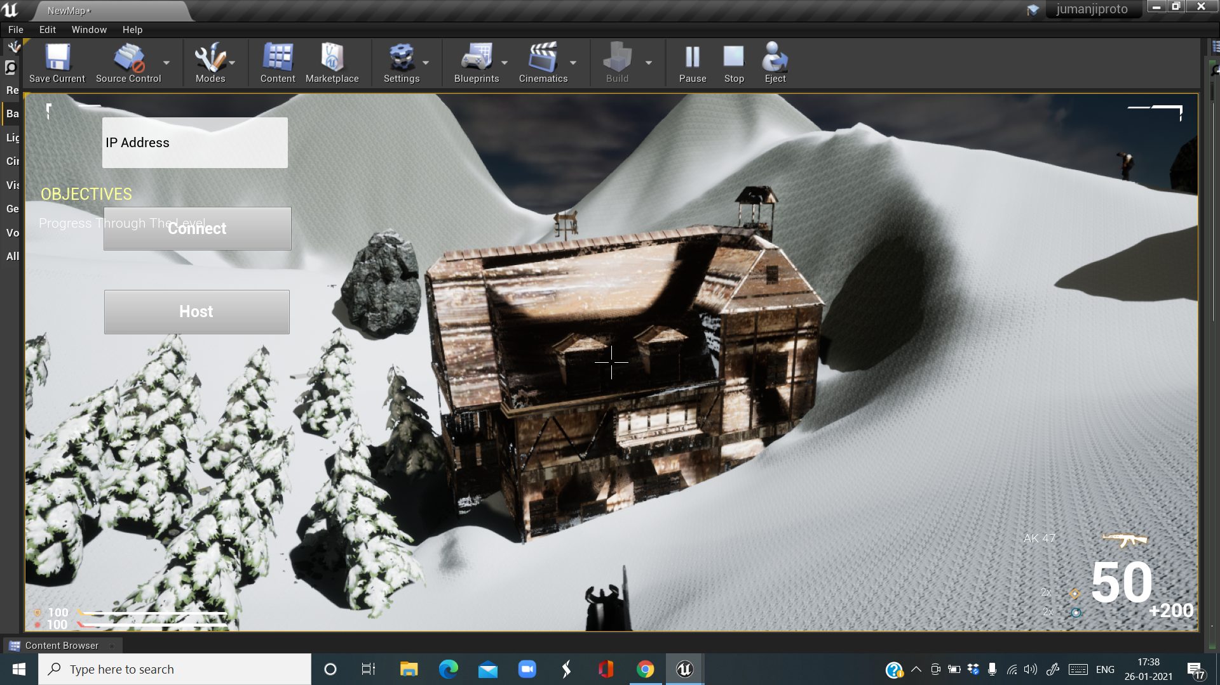
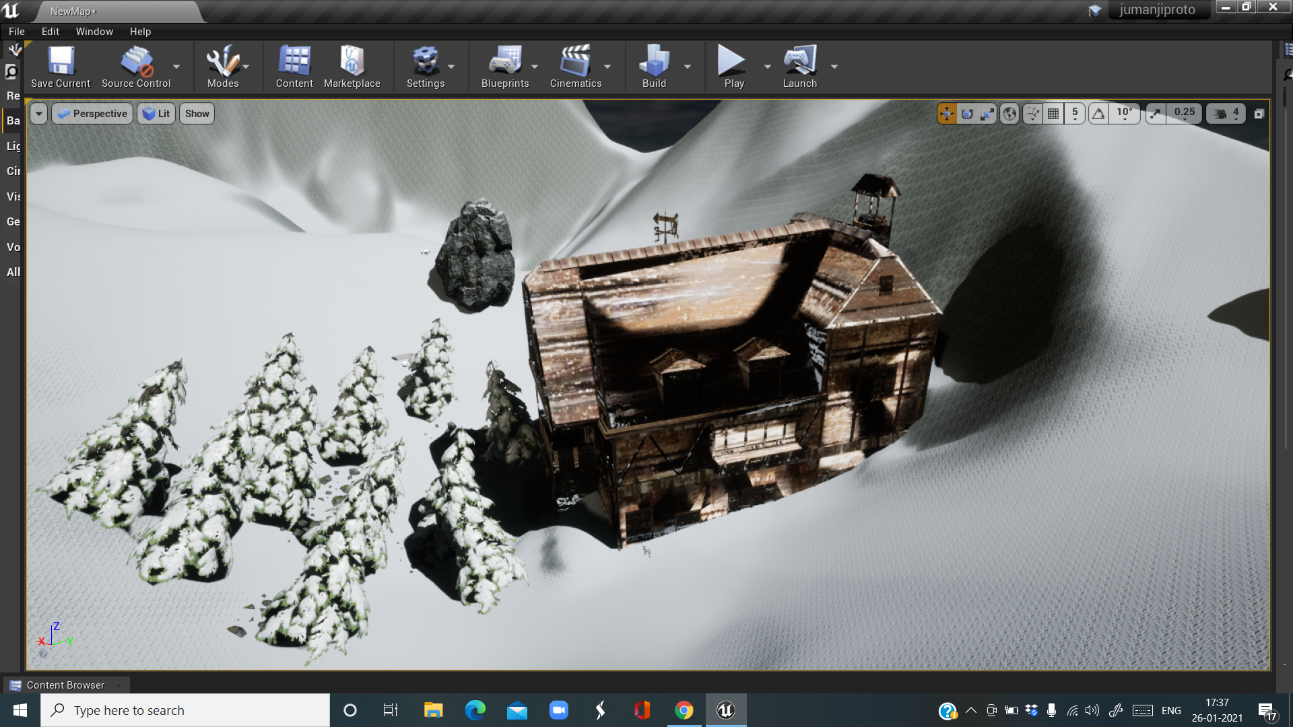
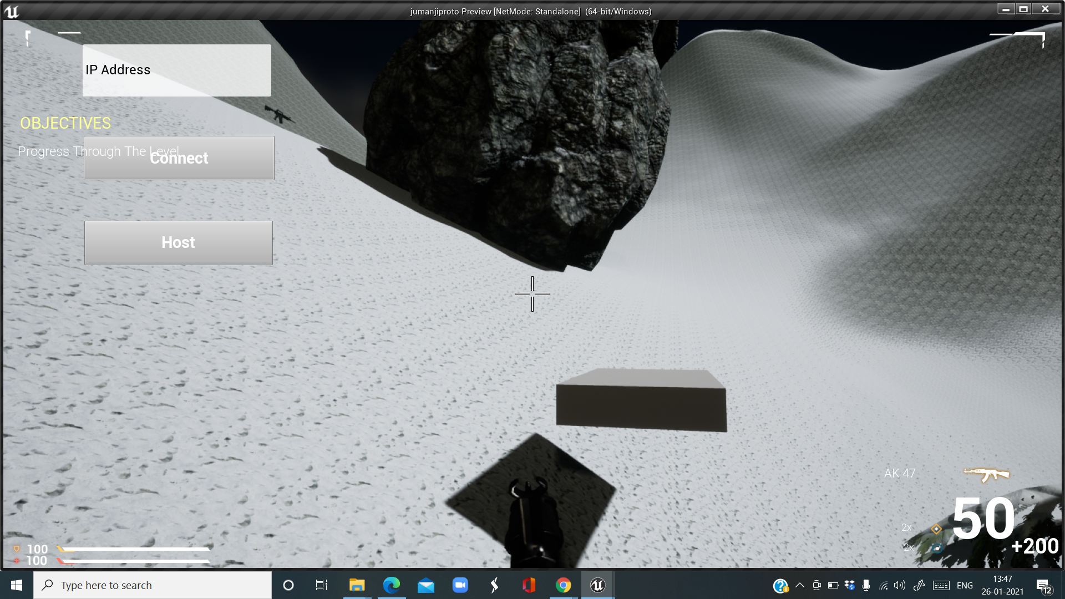
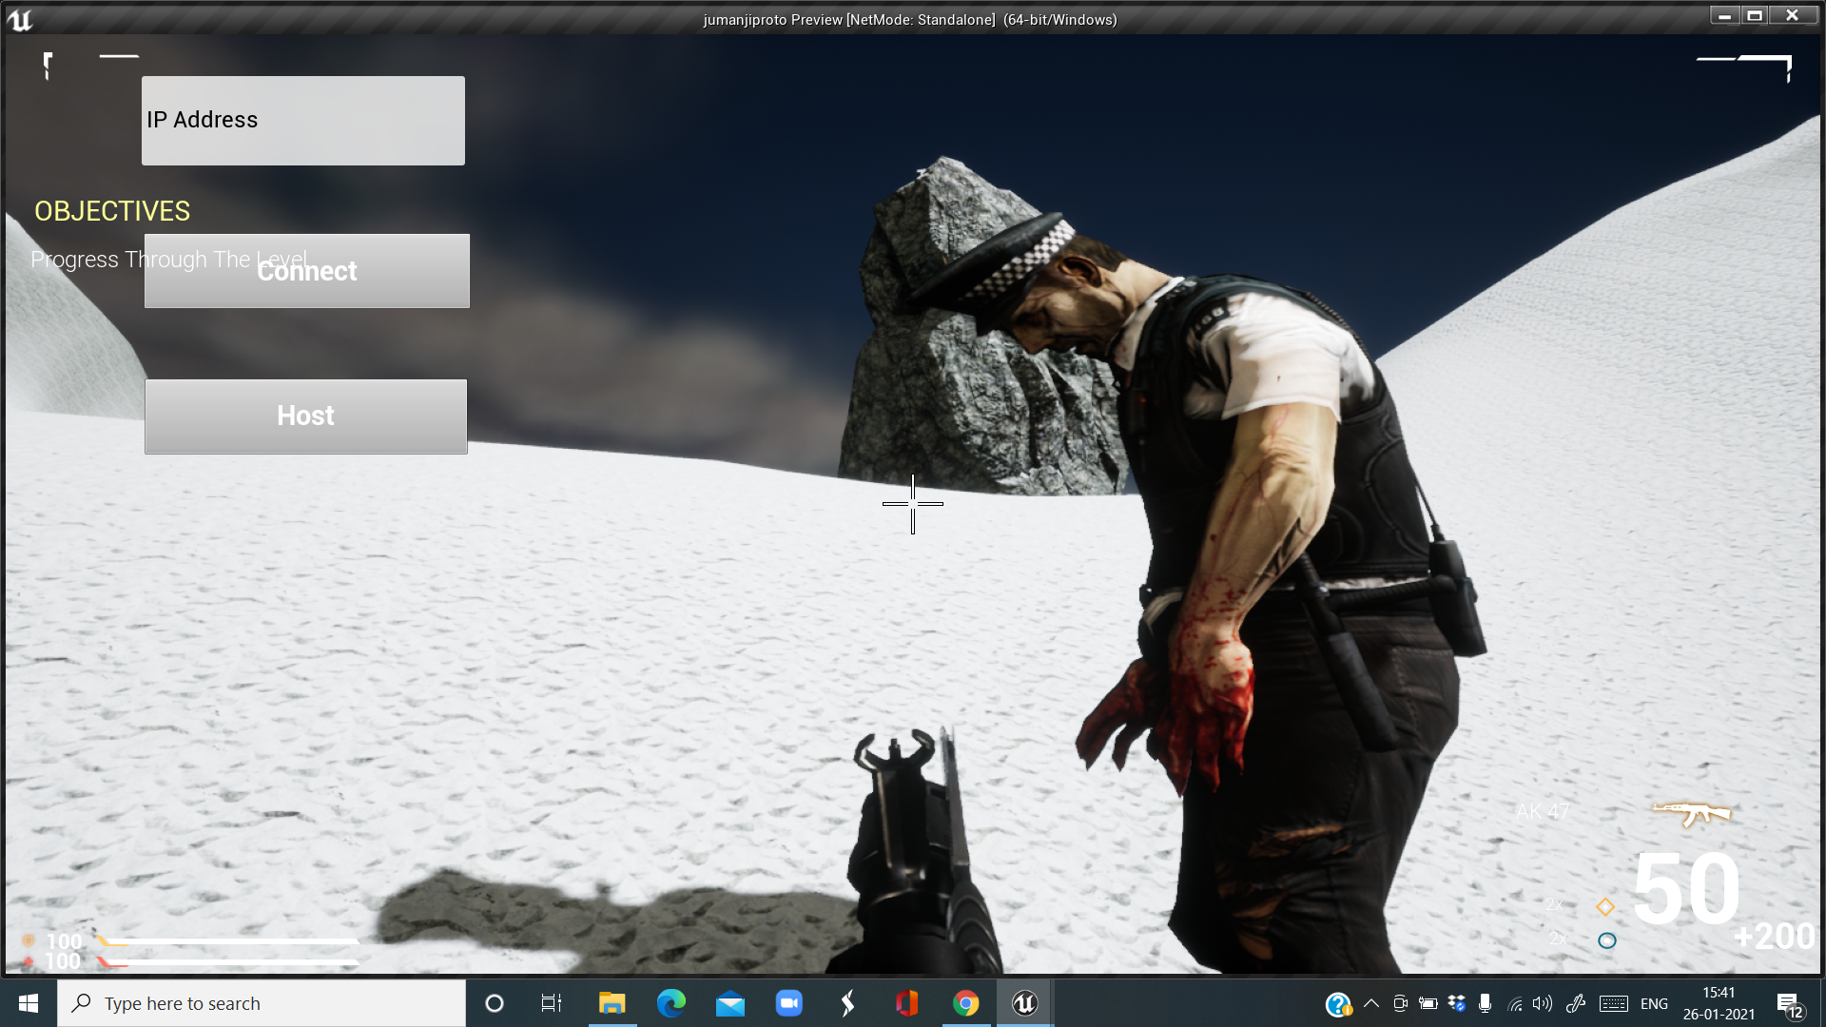
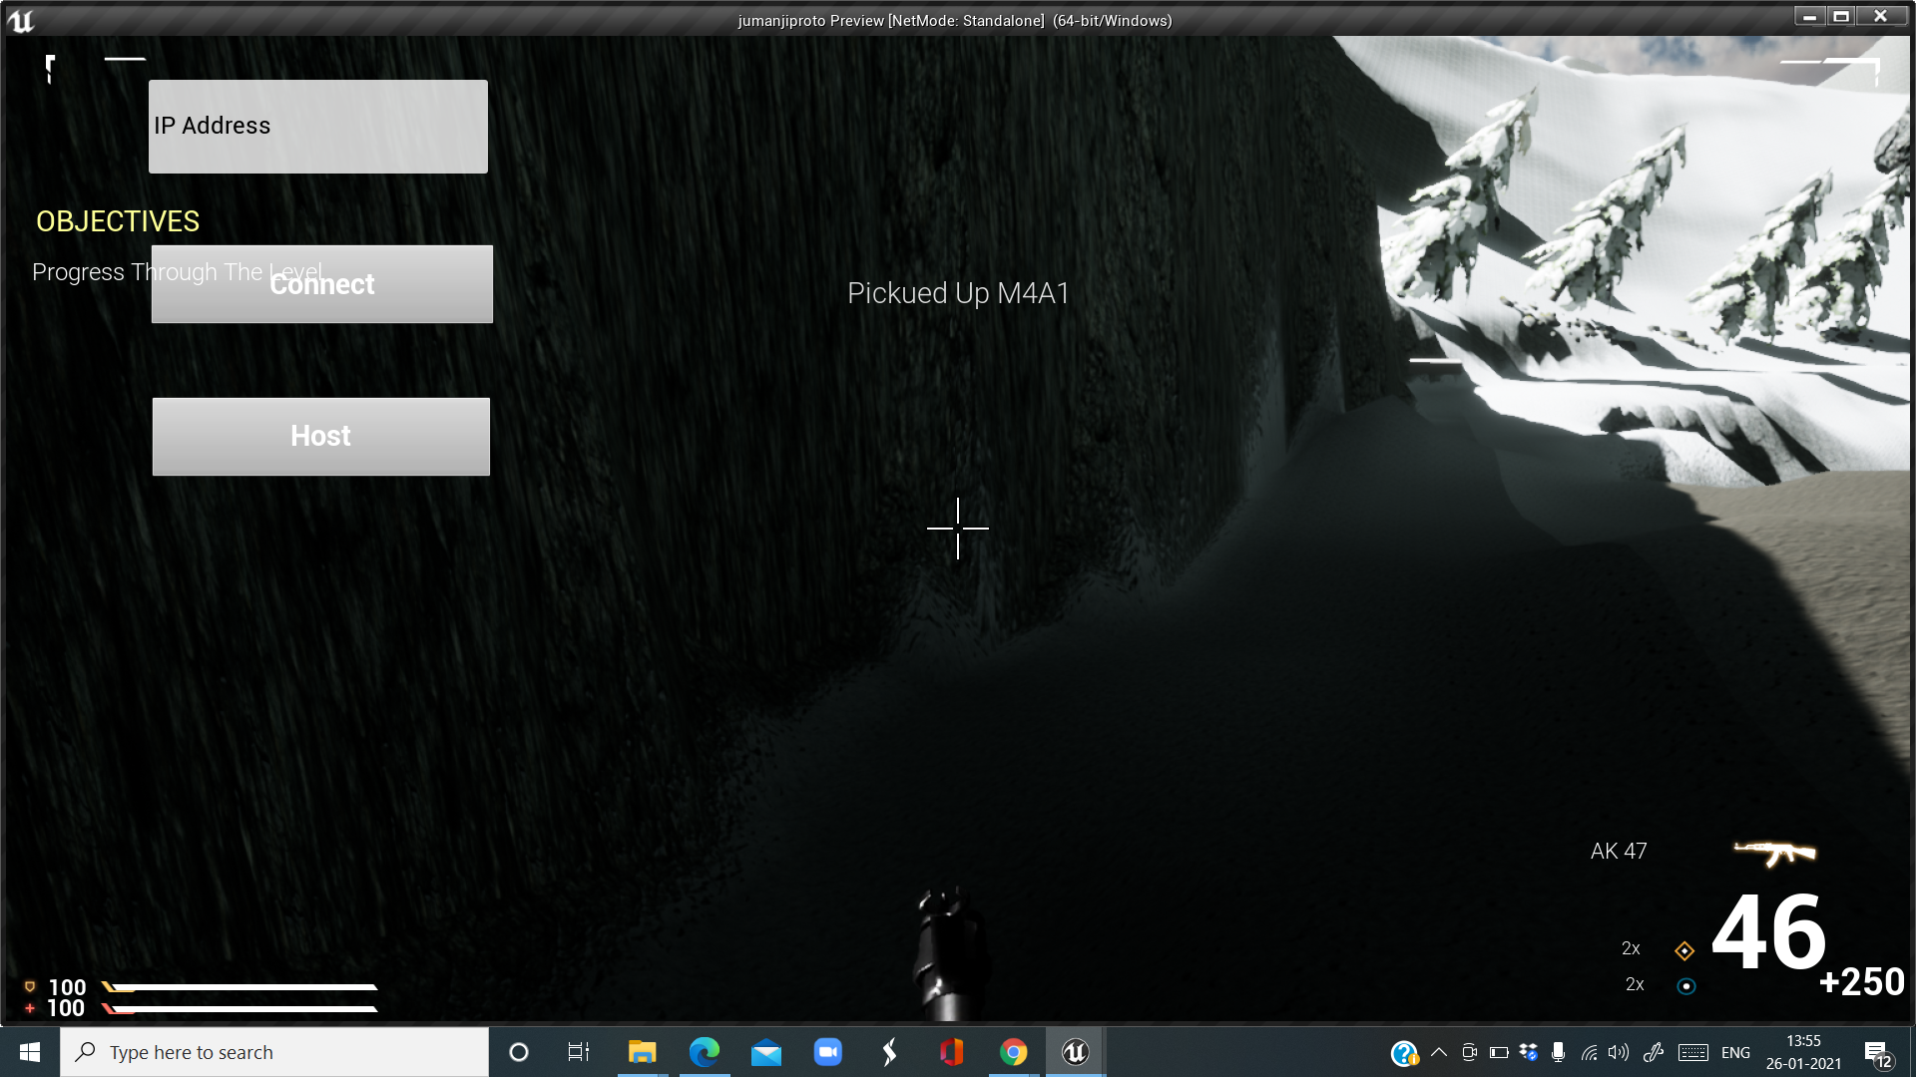
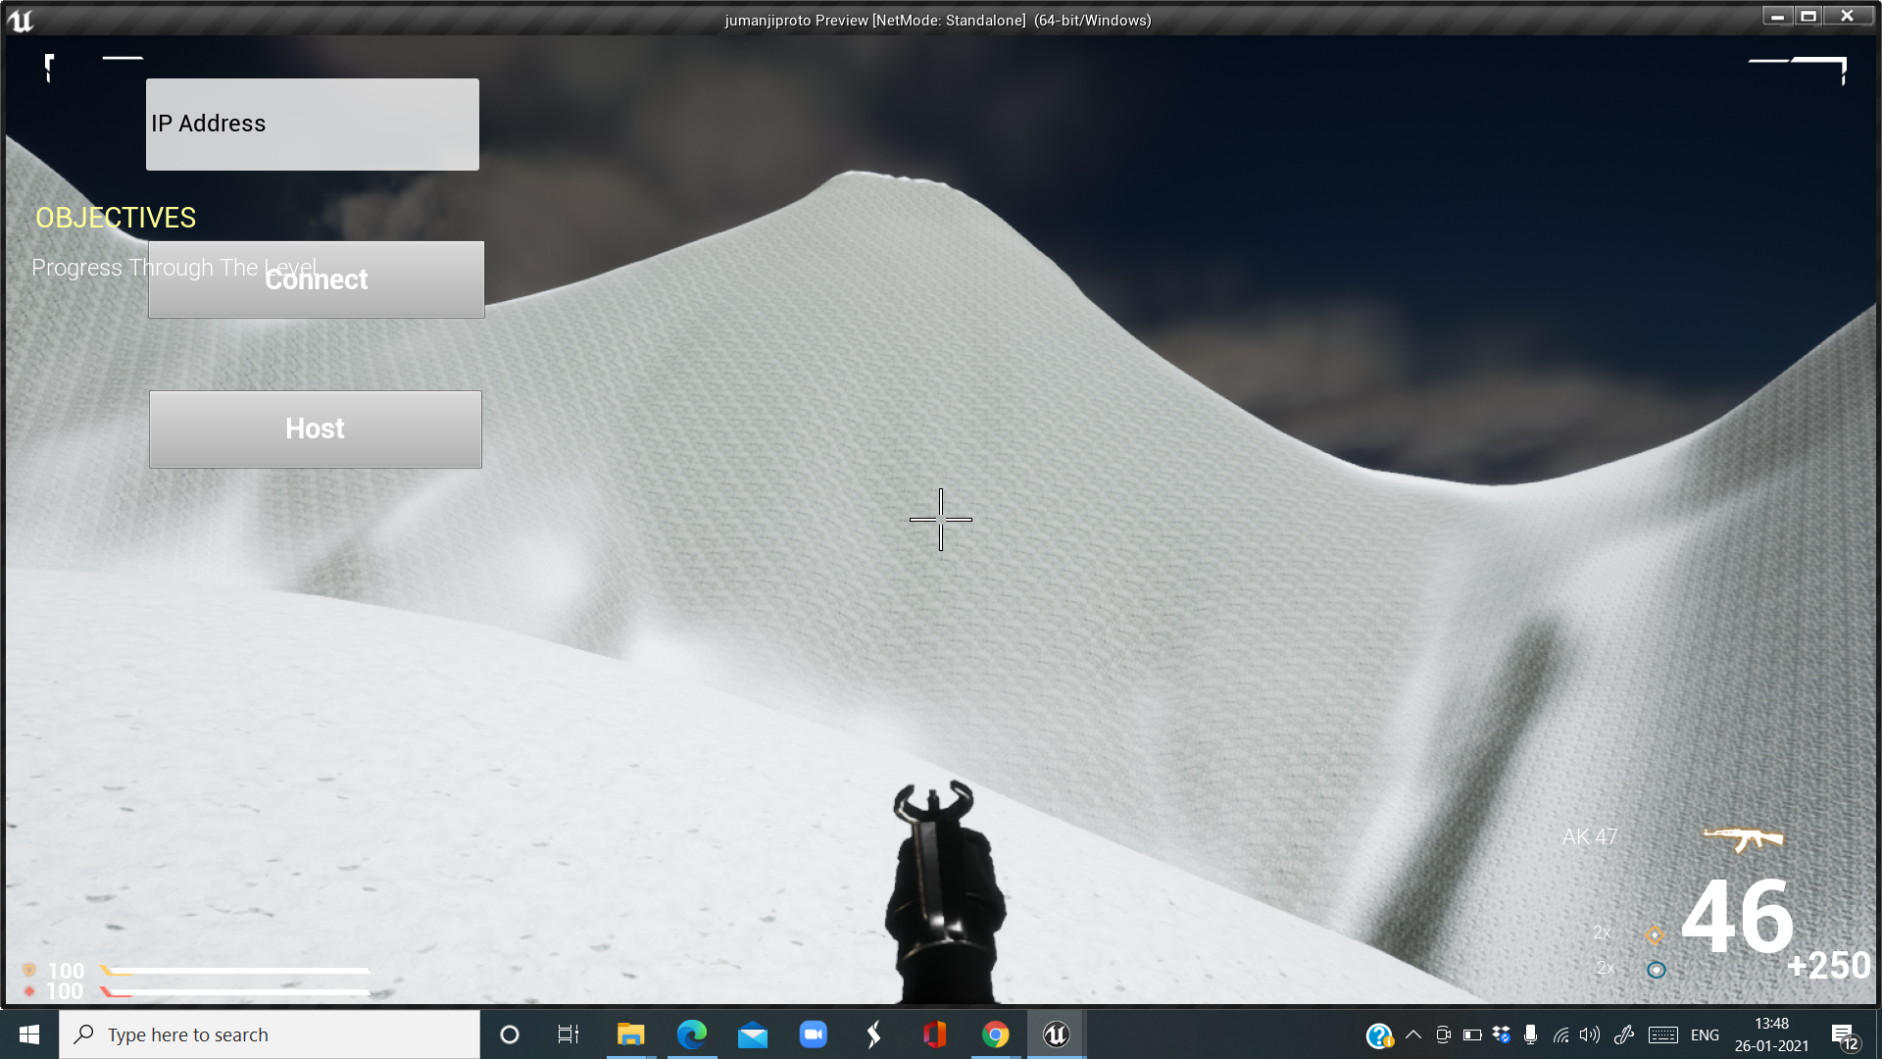
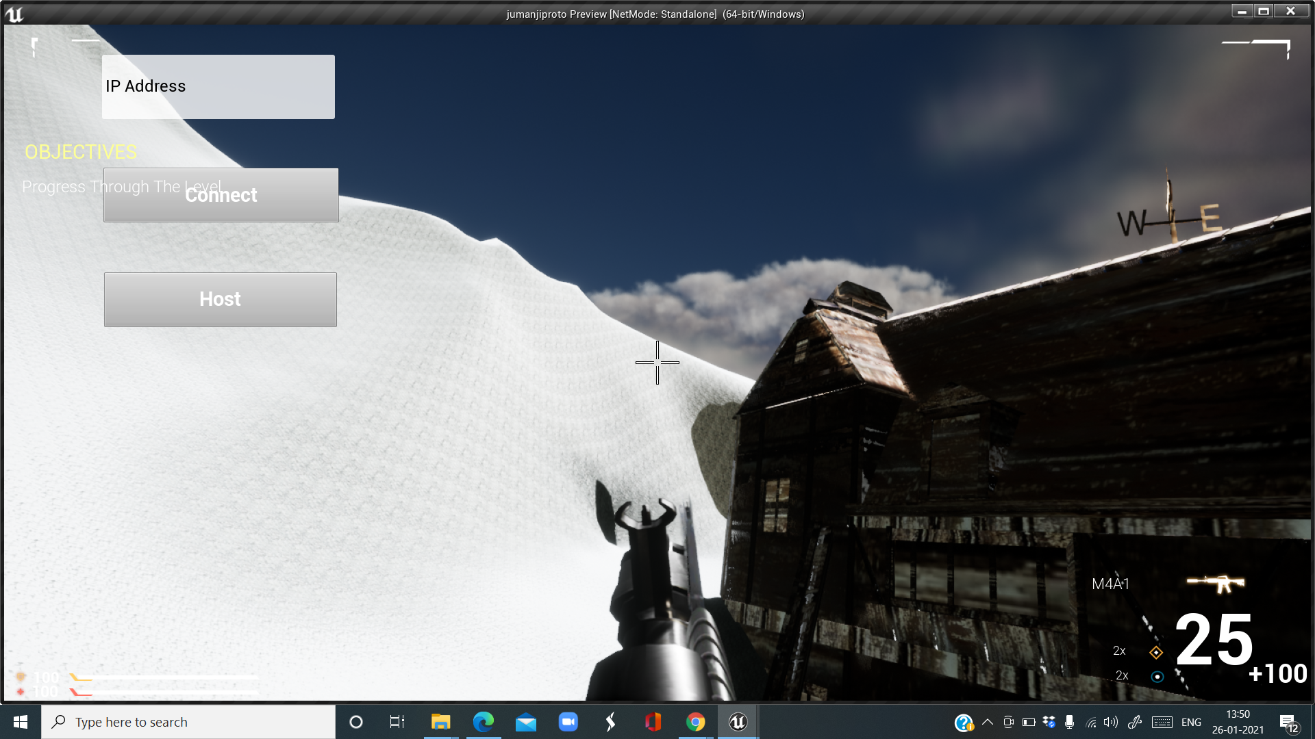
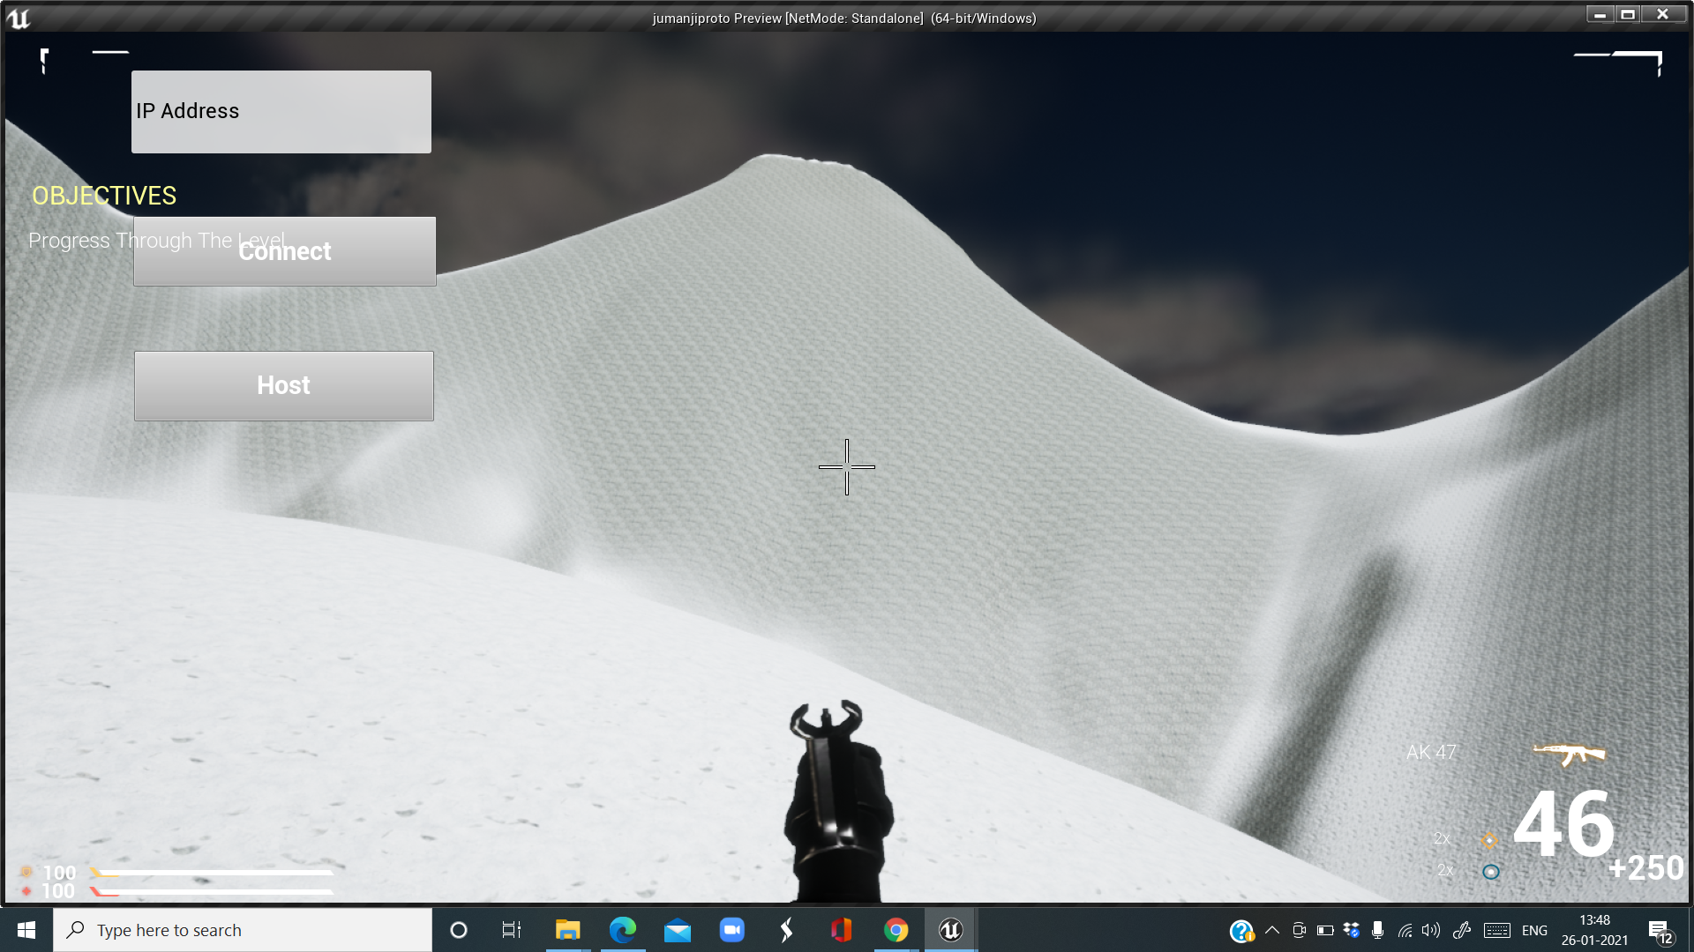
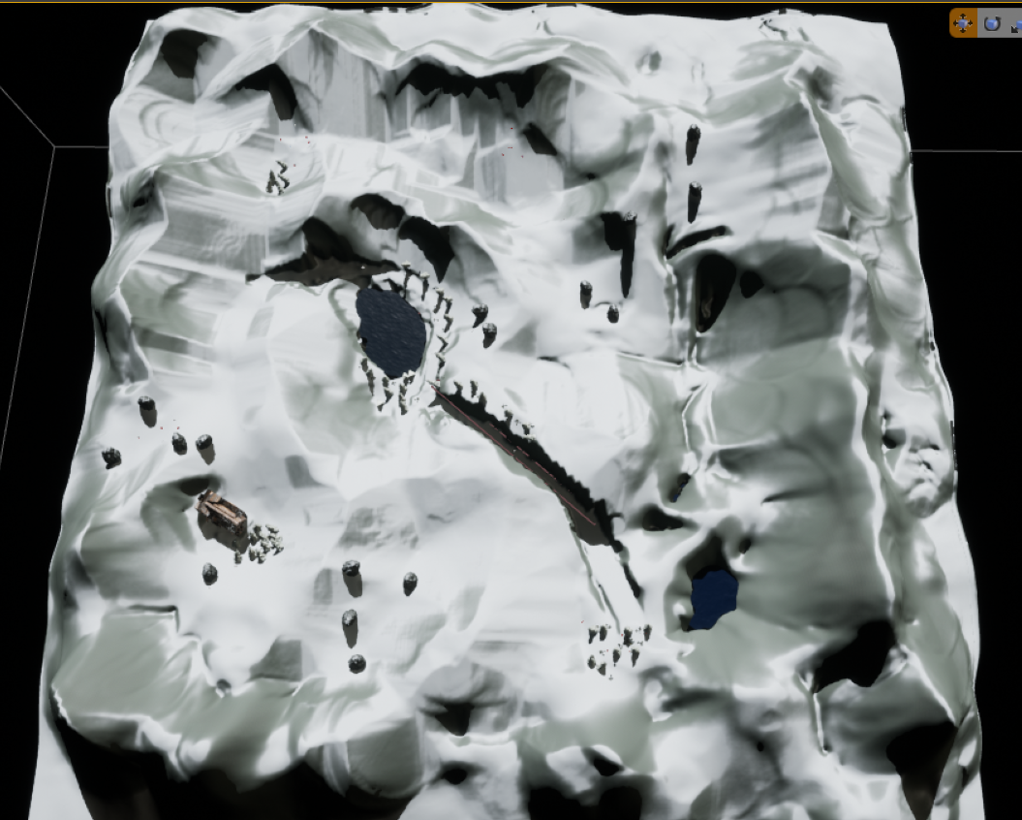
Pics of prototype

Slide 6

THANKYOU

